Slide 1
Talent Development
At HCL

Slide 2
Alerts & Popup

Slide 3
Alert
Alert is a small message box which displays on-screen notification to give the user some kind of information or ask for permission to perform certain kind of operation. It may be also used for warning purpose.
Different Types of Alerts
Simple Alert
Prompt Alert
Confirmation Alert

Slide 4
Simple Alert
Alert is a small message box which displays on-screen notification to give the user some kind of information or ask for permission to perform certain kind of operation. It may be also used for warning purpose.
Different Types of Alerts
Simple Alert
Prompt Alert
Confirmation Alert

Slide 5
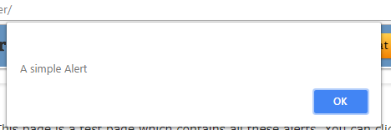
Simple Alert
A simple alert displays some information or warning on screen.

Slide 6
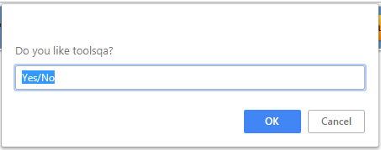
Prompt Alert
This Prompt Alert asks some input from the user and selenium webdriver can enter the text using sendkeys(" input…. ").

Slide 7
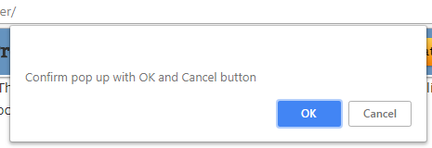
Confirmation Alert
This confirmation alert asks permission to do some type of operation.

Slide 8
Handling Alert
This confirmation alert asks permission to do some type of operation.
Command | Syntax | Purpose
switchTo() | driver.switchTo() | Switching from Windows to Alert
dismiss() | driver.switchTo().alert().dismiss() | To click the “Cancel” button
accept() | driver.switchTo().alert().accept() | To click the “Ok” button
getText() | driver.switchTo().alert().getText() | To capture alert message
sendKeys() | driver.switchTo().alert().sendKeys("Text"); | To send data to alert box.

Slide 9
Code

Slide 10
Code – alertHandling
import org.openqa.selenium.By;
import org.openqa.selenium.WebDriver;
import org.openqa.selenium.chrome.ChromeDriver;
public class alertHandling {
public static void main(String[] args) throws Exception {
// TODO Auto-generated method stub
String url = "http://www.seleniumeasy.com/test/javascript-alert-box-demo.html";
System.setProperty("webdriver.chrome.driver", "D:\\Selenium\\ChromeServer\\chromedriver.exe");
WebDriver alert_WD = new ChromeDriver();
alert_WD.get(url);
//alert_WD.manage().window().maximize();
Thread.sleep(1000);
alert_WD.findElement(By.xpath(".//*[@id='easycont']/div/div[2]/div[1]/div[2]/button")).click();
alert_WD.switchTo().alert().accept();
}
}

Slide 11
Code – alertHandling
import org.openqa.selenium.Alert;
import org.openqa.selenium.By;
import org.openqa.selenium.WebDriver;
import org.openqa.selenium.chrome.ChromeDriver;
public class alerts_accept_dismiss {
public static void main(String[] args) {
String url = "http://demo.guru99.com/selenium/delete_customer.php";
System.setProperty("webdriver.chrome.driver", "D:\\Selenium\\ChromeServer\\chromedriver.exe");
WebDriver driver = new ChromeDriver();
driver.get(url);
driver.findElement(By.xpath("//input[@name='cusid']")).sendKeys("12345");
driver.findElement(By.xpath("//input[@name='submit']")).click();
Alert alert = driver.switchTo().alert();
System.out.println("Text in alert = " + alert.getText());
//alert.accept();
alert.dismiss();
driver.findElement(By.xpath(".//input[@name='res']")).click();
}
}

Slide 12
Code
Download the code from https://github.com/sangramkswain/HCLPuneTraining
File Name – Sessions.zip

